Slide 1
Delete Todo
1. Create deleteTodo method in http.service.ts
This deleteTodo method will call the http delete call
http://localhost:4200/api/todos/{id}
2. Create deleteTodo method in app.component.ts
This deleteTodo method will call the service deleteTodo method
This deleteTodo method will get the id of todo from template
3. call the component deleteTodo method from the template

Slide 2
Update Todo
1. Create updateTodo method in http.service.ts
It will call the http update call
It will send the new updated todo object
It will receive the new updated todo from the component
2. Create updateTodo method in app.component.ts
It will call the updateTodo method of http.service.ts file
It will get the update todo object from the todo form
3. Create handleEdit method in app.component.ts
On click edit icon this function will get called
It will populate the existing data to the form so that user can modify
It will change the submit button text to update

Slide 3
Update Todo
4. Handle onSubmit method
It is currently having the logic to create the todo
It should also handle now updateTodo logic based on edit action

Slide 4
Patch Todo (update completed property)
Patch http call can update the one or more properties.
Put(update) http call will update the all the properties.
Step 1: Create the patchTodoStatus method inside the http.service.ts
It will required the id to update the property
It will also required the updated value of completed property
Step 2: Create the patchTodoStatus method inside the app.component.ts file
It will call the service patchTodoStatus method
It will get the updated value of completed property from the html along with id
On successful response call the getTodos() method to get all the todos in UI.

Slide 5
Patch Todo (update completed property)
Step 3: Update app.component.html
Add ngModel with one way data binding to checkbox
Add change method to call the component patchTodoStatus method

Slide 6
Definite Assignment Assertions
i.e. declaring the property as makes!: any[]; The ! assures typescript that there definitely will be a value at runtime.
It is because typescript 2.7.2 included a strict checking where all properties should be declared in constructor. So to work around that, just add an exclamation mark (!) like:

Slide 7
Understand the Page(pagination) object from the API
"page" : {
"size" : 5, // default value 20 if page query param not provided
"totalElements" : 25,
"totalPages" : 5,
"number" : 0
}

Slide 8
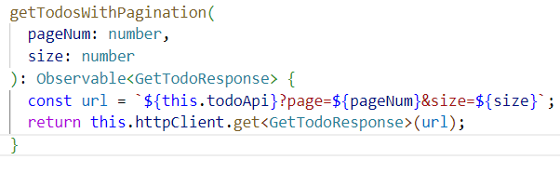
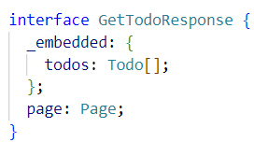
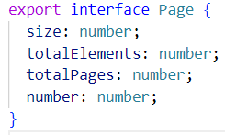
Implementing Pagination Step 1

Slide 9
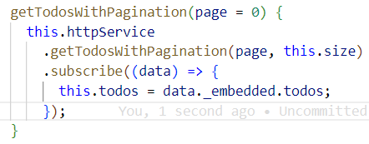
Implementing Pagination Step 2

Slide 10

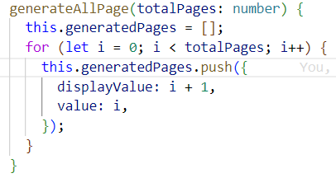
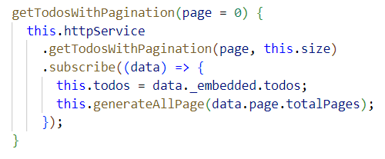
Implementing Pagination Step 3
Create the generateAllPage function | Call this function from the getTodosWithPagination method

Slide 11
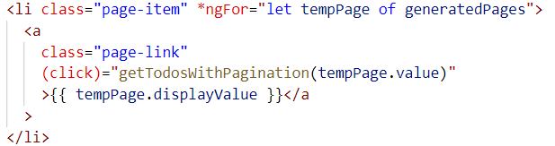
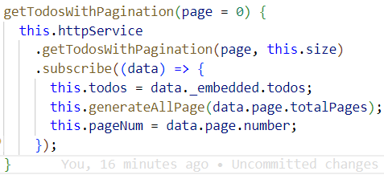
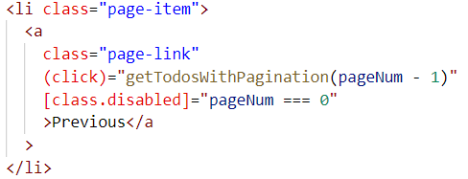
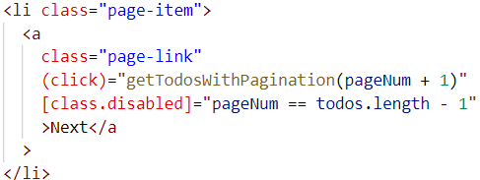
Implementing Pagination Step 4
Display the Generated Page Number in the UI and call the getTodosWithPagination function to get the todos for the page
Call the getTodosWithPagination function on click Previous and Next button

